Slide 1
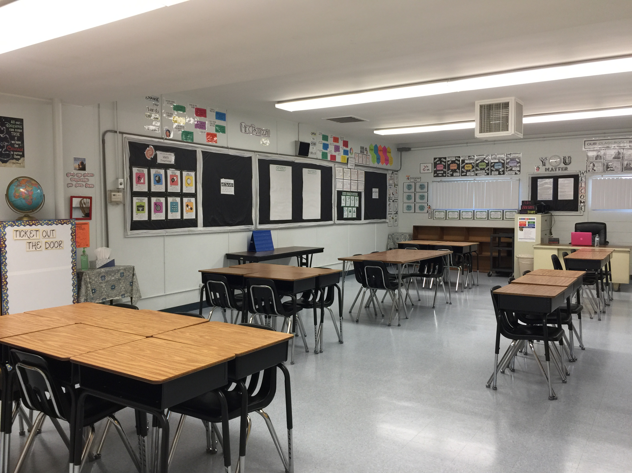
Welcome
Incoming 6th Grade
Parent Meeting
Thursday, May 30th
ST. CATHERINE OF SIENA SCHOOL
SY 2019-2020

Slide 2
OBJECTIVES
By the end of today’s meeting parents and guardians will have:
met middle school teachers
received information about 6th grade schedule, subjects, and other important materials
identified resources for questions and inquiry

Slide 3
Teachers
Mrs. Banzon: Homeroom, Math, Science, Technology, Music, Art, PE
Mr. Korson: English, Literature, Vocabulary
Ms. Regalado: Religion, Social Studies, Spanish

Slide 4
communication
Wednesday Envelope
School website: http://www.stcatherinerialto.com/
Online classroom: www.mrsbanzon.weebly.com
Bloomz: https://www.bloomz.net/parents/
Email: sbanzon@sbdiocese.org; tkorson@sbdiocese.org; aregalado@sbdiocese.org
Gradelink: https://gradelink.com/student-parent-access/#mobileapp

Slide 5
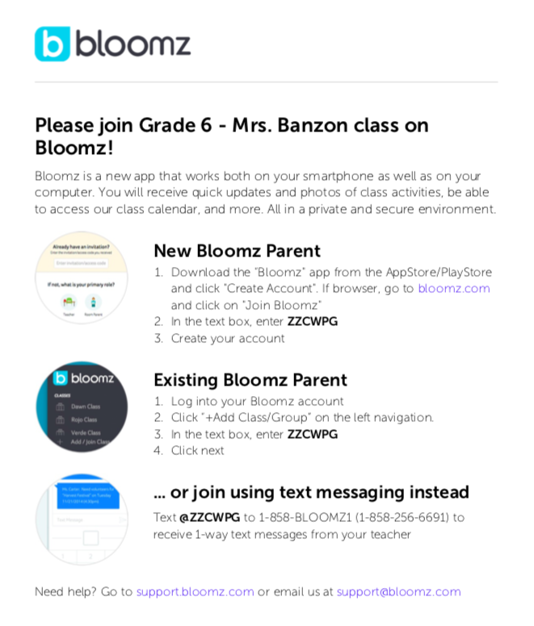

Slide 6
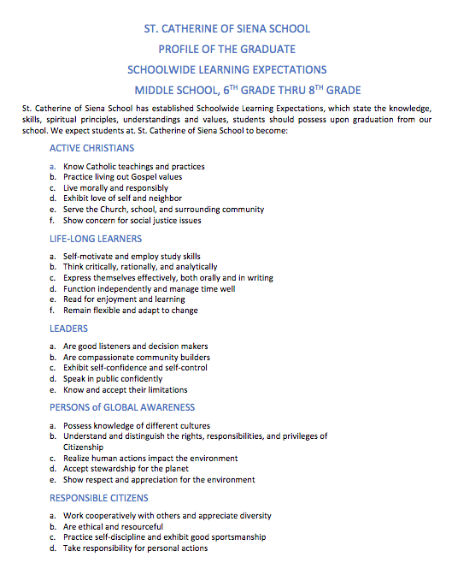

Slide 7
Classroom Environment
High expectations for all students- Differentiated instruction for all learners
Project-based learning
Consistent and fair environment
Variety of learning settings: independent, partners, group
Follow class procedures
Give your best

Slide 8
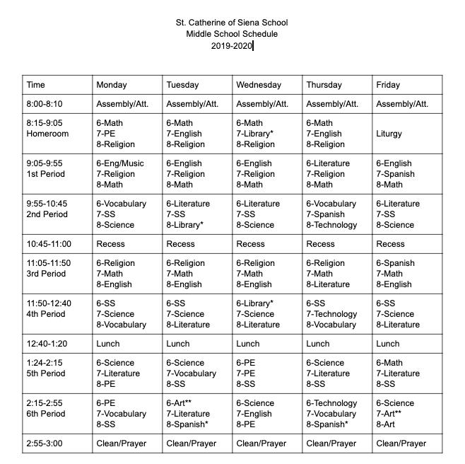

Slide 9
Curriculum
Math- Common Core State Standards: Math Practices, Ratios & Proportional Relationships, The Number System, Expressions & Equations, Geometry, Statistics & Probability
Science- Next Generation Science Standards: Science & Engineering Practices, Earth Science, Life Science, Physical Science, Earth & Human Activity
Technology- Digital Citizenship, Project-based and aligned with curriculum, Coding, 1:1 iPad ratio, Pages, Numbers, Keynote, iMovie, Apple Apps
PE & Art

Slide 10
Mr. korson
Ms. regalado

Slide 11
iPad
Case for iPad Air 2
Technology Reminders
-Students must have their iPads everyday. -iPads need to be charged for the next day's use (in the charging carts or at home using approved Apple chargers- not provided by school) -Bring earbuds everyday -iPad apps disable at 9pm, enable at 8am -iPads are for school use and not personal use -Students may take iPads home if there are school assignments to be completed
Please leave iPads charging in the carts on Fridays. Maintenance are scheduled in the weekends. *Merit points will be deducted if a student does not have his/her charged iPad and earbuds for class.

Slide 12
Behavior Expectations
St. Catherine of Siena School: respectful, responsible & safe environment for all
Rewards: schoolwide & classroom
Consequences: verbal warning, 2nd warning, loss of merit point/s, principal’s office, parent conference
NO to disrupting the learning environment, talking back, defiance
NO to physical hitting/pushing, harassment, hate speech

Slide 13
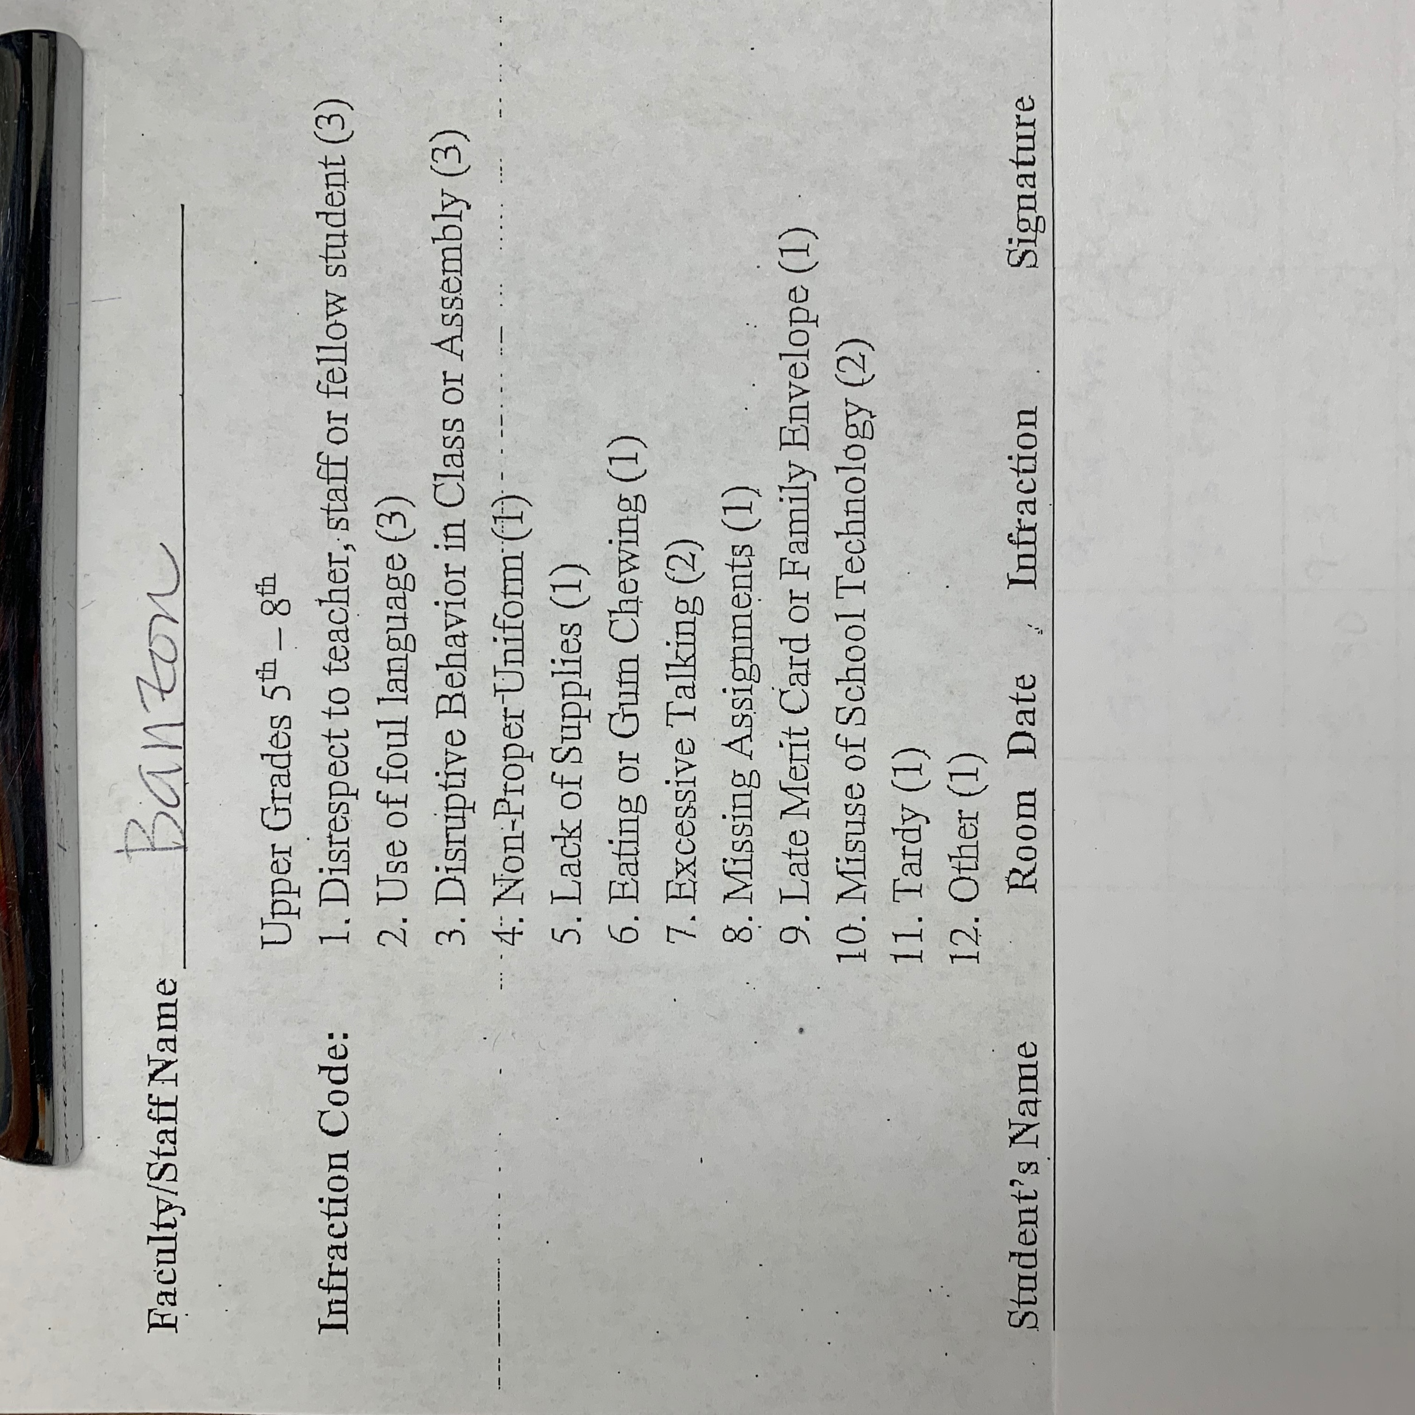
MERIT CARD

Slide 14
Homework Expectations
Assigned Homework, unfinished Classwork
“Other” assignment at teacher discretion
Long term projects
Please sign planners nightly
Parent help welcome when appropriate. Don’t DO homework, HELP with homework!
All homework & assignments must be completed on time

Slide 15
long term projects
Trimester 1: Literature Fair
Trimester 2: Science Fair
Trimester 3: History Fair

Slide 16
summer assignments
Math Packet
Reading Assignment
Social Studies Current Events

Slide 17
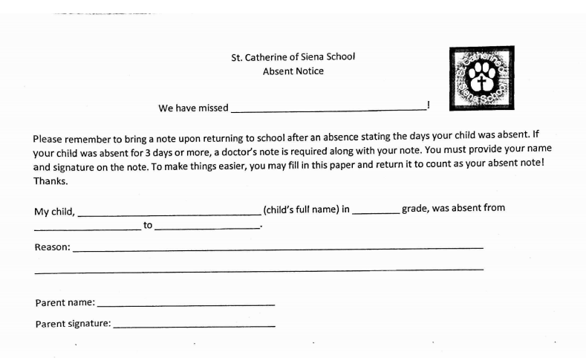
Absent Notice

Slide 18
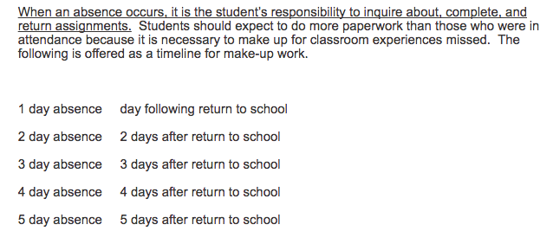
Absent work policy
“Day for a Day”

Slide 19
late work policy
Full credit is possible if it is turned on the due date at the beginning of class.
If work is turned in within 24 hours of original due date, the maximum credit received will be lowered by one letter grade.
After 48 hours (2days) of the original due date, the maximum credit received will be lowered by a second letter grade.
Assignments will receive no more than 50% credit if turned in after 72 hours (3 days). All assignments must be turned in before the completion of the unit/chapter to receive 50%. All required work must be turned in or privileges will be lost.

Slide 20
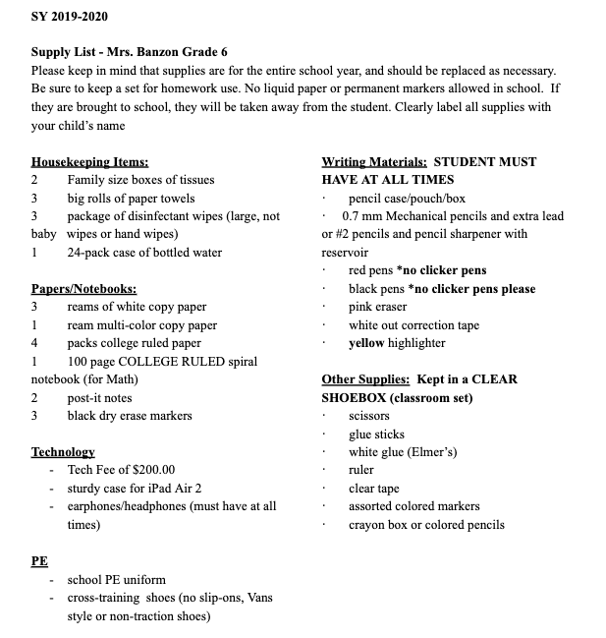

Slide 21
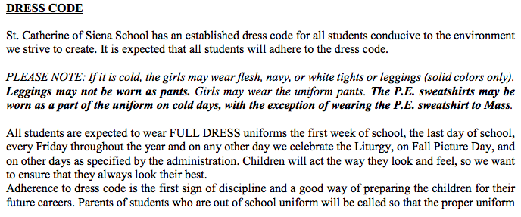
Uniform policy

Slide 22
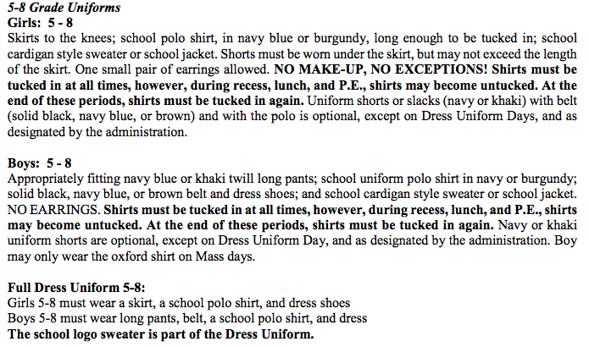
Uniform policy

Slide 23
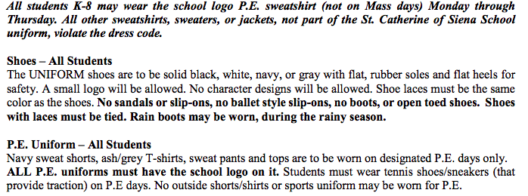
Uniform policy

Slide 24
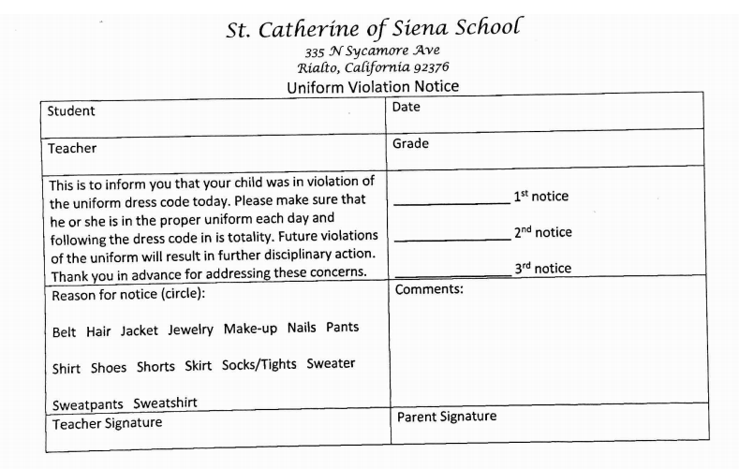
Uniform policy

Slide 25
What You Could Do To Help
Encourage self-advocacy
Volunteer at the school & in the classroom
Encourage your child to read, complete homework nightly, get enough sleep, eat a good breakfast, and come to school on time
Go to Gradelink to monitor your child’s grades
Check the online classroom for updates (mrsbanzon.weebly.com)
Open lines of communication (Bloomz)

Slide 26
Thank you for being here!
Thank you for the time you put in!
Thank you for the contributions you all make!
Thank you for helping get supplies to our class!
Thank you for caring!
What you do makes a big difference!

